Slide 1
Algorithms Fundamentals (with Java)
Course Introduction
SoftUni Team
Technical Trainers
Software University
https://softuni.bg/

Slide 2
Have a Question?
sli.do
#Algorithms-Java

Slide 3
Table of Contents
Course Objectives
Training and Team
Course Organization
Course Infrastructure
Evaluation Criteria

Slide 4










SoftUni Diamond Partners

Slide 5



Educational Partners

Slide 6

Course Objectives

Slide 7
Course Objectives
Working with recursion and backtracking
Solving combinatorial problems
Searching, sorting and Greedy algorithms
Graph theory representation, traversal and shortest paths
Dynamic programming
Understanding solving techniques and choosing between multiple solutions

Slide 8
Practical Programming Exam
Exam
3 practical problems – four hours
Recursion and backtracking
Combinatorial problem
Searching, sorting and Greedy
Graph theory
Dynamic programming
Everything included in the course

Slide 9
Theoretical Exam
You will have 15 minutes once you enter
10 questions with:
Multiple choice with only one correct answers
English
Automated quiz system
Available online at the day and time of the practical exam
You can submit your answers just once

Slide 10

The Team

Slide 11
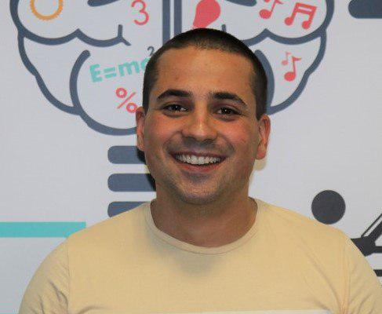
Martin Paunov
Java Developer at Virtual Racing School
Experience with Java, C++, C#
Technical Trainer @ SoftUni

Slide 12

Course Organization

Slide 13

Homework Assignments & Exercises
Your homework:
Lesson days → slides + live demos + exercises + tests
How to submit your homework?
For practical problems: Submitted in the judge system
For tests https://quiz.softuni.bg/
Do your homework when it's due
Assignments pile up quickly

Slide 14


Scoring System for the Course
Theoretical Exam 5%
Practical Exam 95%
Bonus Homework 5 %
Evaluation

Slide 15



Course Web Site, Forum and FB Group
Official web site:
Official discussion forum:
Official Facebook group:
https://softuni.bg/trainings/2991/algorithms-fundamentals-with-java-may-2020
https://softuni.bg/forum
https://www.facebook.com/groups/AlgorithmsFundamentalswithJavaMay2020/

Slide 16
https://softuni.bg/trainings/2991/algorithms-fundamentals-with-java-may-2020

Slide 17












SoftUni Diamond Partners

Slide 18




SoftUni Organizational Partners

Slide 19




Trainings @ Software University (SoftUni)
Software University – High-Quality Education and Employment Opportunities
softuni.bg
Software University Foundation
http://softuni.foundation/
Software University @ Facebook
facebook.com/SoftwareUniversity
Software University Forums
forum.softuni.bg

Slide 20

License
This course (slides, examples, demos, videos, homework, etc.) is licensed under the "Creative Commons Attribution-NonCommercial-ShareAlike 4.0 International" license

